Slide 1
“Review-1 of Major Project”
for E-4 2018 Admitted Batch
Submitted as part of Major Project.
1. D. Keerthi- S180532
2. P. Kumari- S180192
3. Sk. Haseena Begum- S180720
4. J. Leela Satyasri- S180543
Under the Supervision of:
Mrs.Ch.Lakshmi Bala, M.Tech(Ph.D)
Assistant Professor, Head of the Department (HOD)
Department of Computer Science and Engineering
Rajiv Gandhi University of Knowledge Technologies
Srikakulam – 532402

Slide 2
Project Title “Speech Based Automated Note-Making System”

Slide 3
AGENDA
PROBLEM STATEMENT
INTRODUCTION
ABSTRACT
SCOPE OF THE PROJECT
GOAL AND OBJECTIVE
EXISTED AND PROPOSED SYSTEMS
METHDOLOGIES AND TECHNOLOGIES
ADVANTAGES
INTERFACE
CONCLUSION
REFERENCES

Slide 4
PROBLEM STATEMENT
Traditional note-taking methods (like handwritten or typed documents) are time-consuming and inefficient, especially in this fast-paced world. Accuracy and completeness of notes are often compromised.To address this challenge, a Speech-Based Automated Note-Making System is proposed. This system uses speech recognition technology to seamlessly convert spoken words into text, eliminating the need for manual note-making or document preparation and writing emails.

Slide 5
INTRODUCTION
The real-time transcription of spoken-words to text acts like a powerful tool for note-making.
With this speech recognition tool, the goal is to simply input any continuous audio speech and output the text equivalent (like documents and e-mails etc ).
We want our Speech Recognition system to be speaker-independent and have high accuracy.

Slide 6
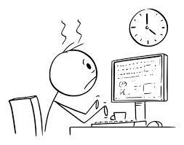
EXAMPLE
A student is struggling to make the documents for his academics. Frustrated, he switches on her speech-based note-taking system . This device effortlessly transcribes his words into text. So that he can easily prepare for upcoming exams as the time is saved.

Slide 7
ABSTRACT
In an increasingly digital and fast-paced world, efficient note-making remains a fundamental skill for information retention and productivity. However, manual note-making can be difficult, especially while making documents. To address this challenge, a Speech-Based Automated Note-Making System is proposed. Most of the existed systems converts speech-to-text only. Our proposed system uses speech recognition technology to seamlessly convert spoken words into written text, and also used to write emails. The system begins by capturing audio input from a user's microphone or a designated source. A speech recognition engine is employed to transcribe the spoken words into text accurately and efficiently. The resulting text is then processed and organized as notes, which can be saved for future reference. Users are provided with a user-friendly interface that enables them to initiate the speech recognition process, start recording and manage their notes effortlessly. This Speech-Based Automated Note-Making System, is a valuable tool for capturing and organizing information quickly and accurately, freeing them from the limitations of manual note-making and document preparation.
Keywords:
Automated, Interface, Speech recognition.

Slide 8
SCOPE OF THE PROJECT
Develop an advanced speech recognition system capable of accurately transcribing spoken words into text.
Create an efficient mechanism to organize the transcribed and processed text into well-structured documents based on predefined templates or user-defined formatting rules.
Aim to provide real-time transcription and document creation to enhance productivity and efficiency in dynamic settings.

Slide 9
GOALS
With automatic speech recognition, the goal is to simply input any continuous audio speech and output the text equivalent.
Our Speech Recognition system to be speaker-independent and have high accuracy, efficiency with user-friendly interface.
.

Slide 10
OBJECTIVES
Enable real-time speech-to-text transcription during live events, meetings, or conversations for immediate access to written content.
Develop an accurate speech recognition system to minimize transcription errors and improve the reliability of the generated text.

Slide 11
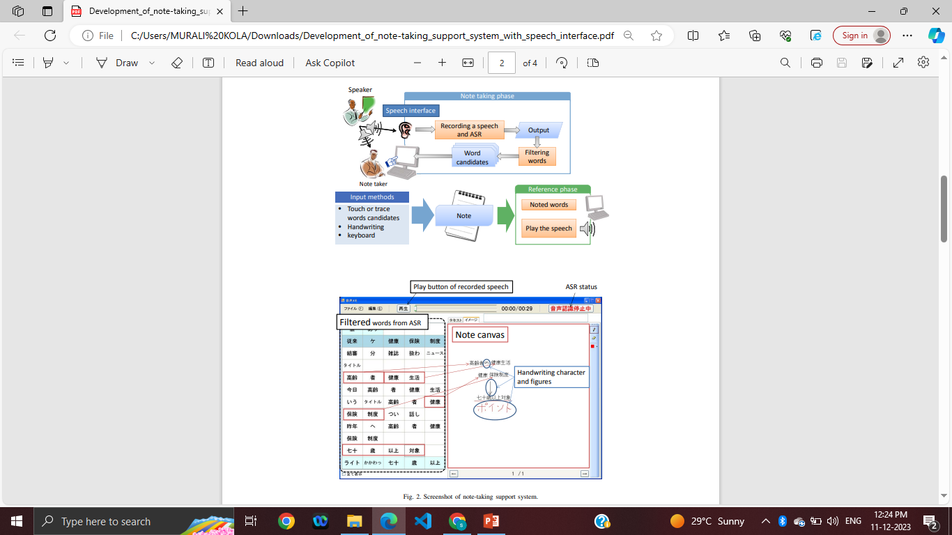
EXISTED SYSTEM
Development Of Note-Taking Support System With Speech Interface: It capture the speech and perform automated speech recognition system and user can replay the recorded speech(audio file) , user can also write and modify the text.

Slide 12
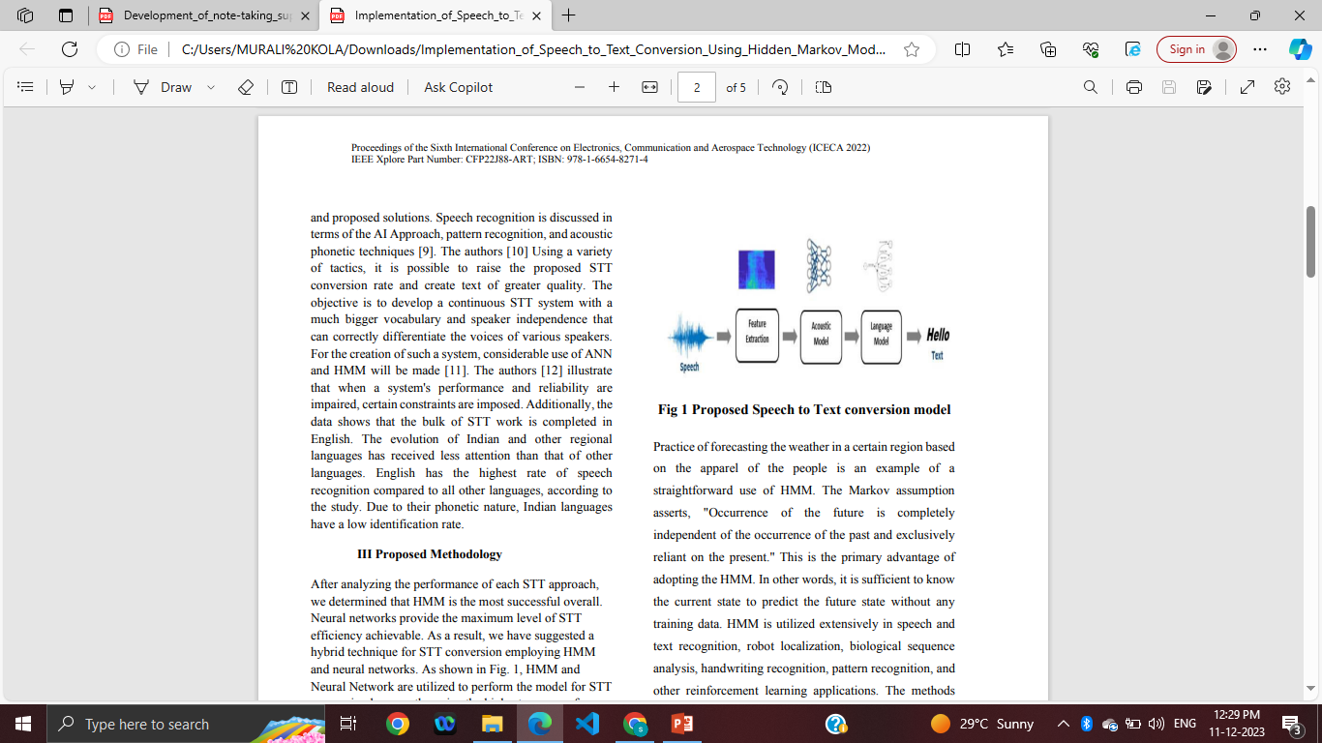
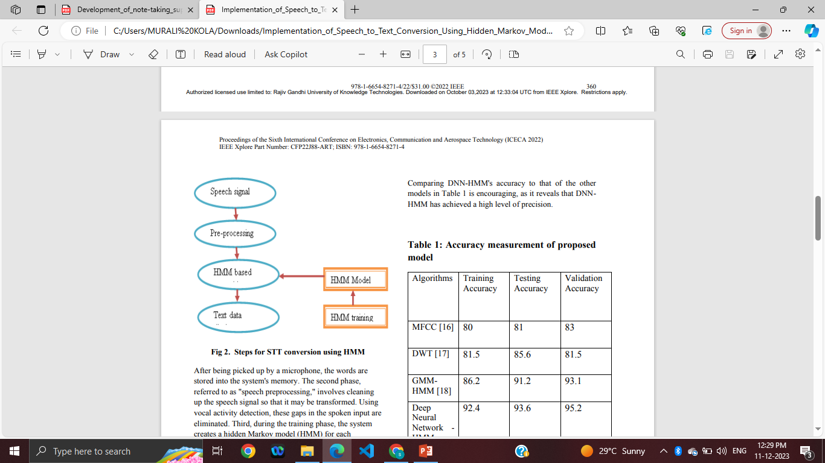
Speech-To-Text Conversion Using Hidden Markov Model: Using HMM used for speech recognition and used digital signal processing algorithm for converting audio files into text.

Slide 13
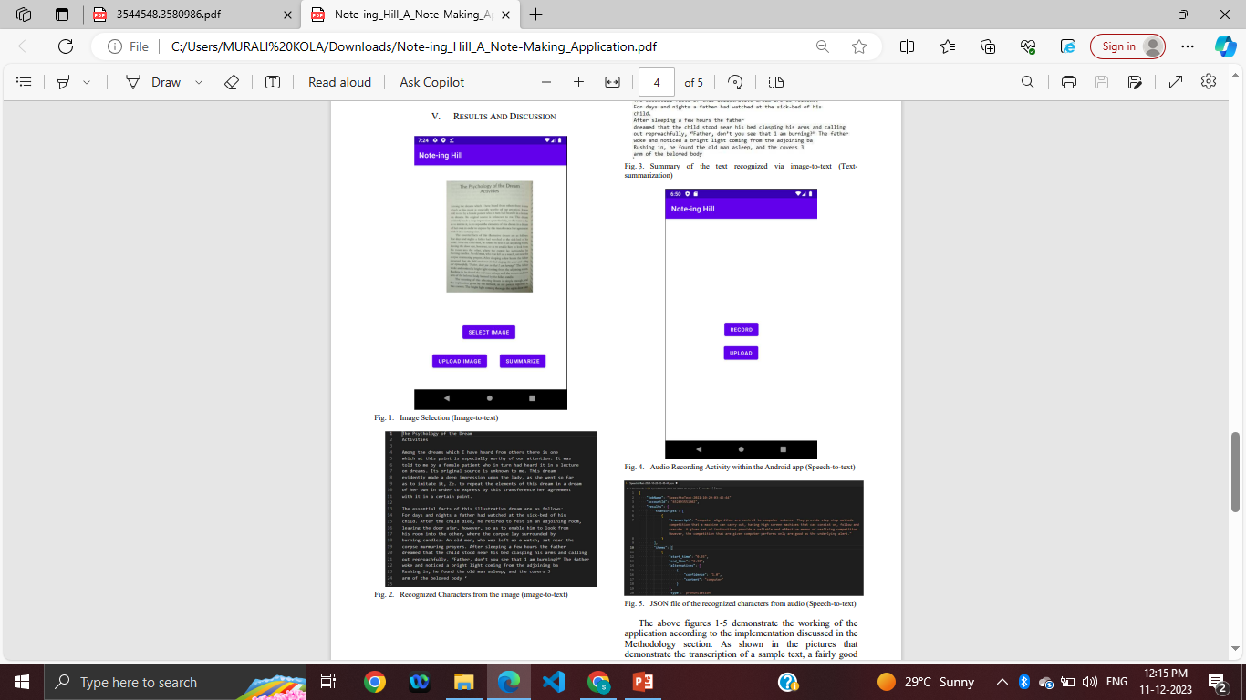
Note-ing Hill: A Note Making Application: Used Textrank, Amazon Transcribe , Tesseract OCR and it provide text summarization, speech to text, image to text.

Slide 14
PROPOSED SYSTEM
The proposed system encourages digital note taking system i.e. speech based automatic note-making system.
It is Used to create the customized document preparation or organizing the notes.
It is used to write the E-mails.
It is used to translate the speech into text Accurately and efficiently.

Slide 15
1. Sending Emails:
Users can use voice commands to:
Compose Content: Dictate the email's body, addressing recipients, and specifying the message content verbally.
Set Recipients: Speak the email addresses or contact names to whom the email should be sent.
Send Email: Use voice commands to send the email once it's composed, eliminating the need for manual clicking or tapping.
2. Editing and Formatting:
Voice commands facilitate:
Editing Text: Users can verbally edit or modify the email content, making changes to sentences, phrases, or formatting elements like bold, italics, etc.
Formatting Emails: Apply formatting styles such as font changes, bullet points, headings, or paragraph alignments by voice commands.

Slide 16
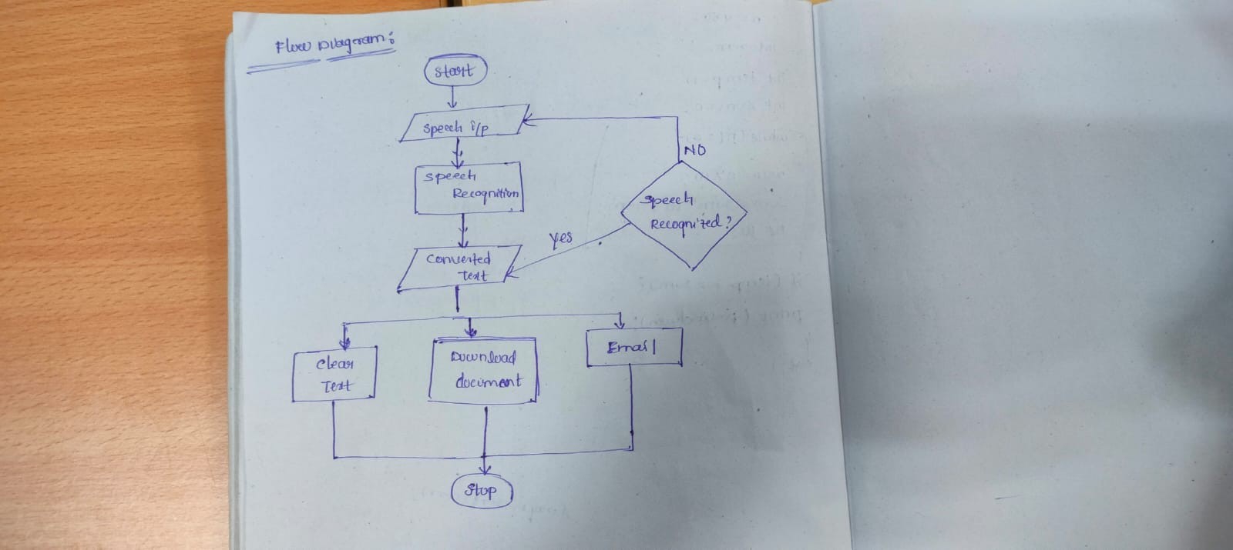

Slide 17
ADVANTAGES
Like all forms of technology, speech to text has many benefits that help us improve daily processes. These are some of the main advantages of using speech to text:
Save time:Automatic speech recognition technology saves time by delivering accurate transcripts in real-time.
Cost-efficient:Most speech to text software has a subscription fee, and a few services are free. However, the cost of the subscription is far more cost-efficient than hiring human transcription services.
Enhance audio and video content: Speech to text capabilities mean that audio and video data can be converted in real-time for subtitling and fast video transcription.
Streamline the user experience: The user experience is transformed through ease, accessibility, and seamlessness.

Slide 18
METHODOLOGIES
Speech Recognition : Utilizes state-of-the-art automatic speech recognition (ASR) models trained on large datasets to accurately convert spoken words into text . Employs deep learning architectures such as recurrent neural networks (RNNs) or transformer models for robust and context-aware transcription
Algorithms: Hidden Markov Model or Julius Decoder
Natural Language Processing (NLP): Applies NLP techniques such as Named Entity Recognition, POS Tagging etc. for creating email format.

Slide 19
TECHNOLOGIES
Front-end Development : HTML, CSS, JavaScript
HTML: Used to design an interface layout
CSS: Used for styling
JavaScript: Used to interact with web speech API and to create a responsive webpage.
Backend Development: Flask/Flutter
Flask: Flask refers to a micro web framework written in Python. It is designed to be lightweight and easy to use, making it an excellent choice for developing web applications and APIs.
Flutter: Flutter is an open-source UI software development toolkit created by Google. It is used to build natively compiled applications for mobile, web, and desktop from a single codebase.

Slide 20
INTERFACE
The proposed system enables user to give speech as input through an user interface created with frontend-development technologies like CSS, HTML, JavaScript.
The “start recording” button enables the microphone to recognize speech.
The interface makes choice of selecting language to speak.
We can download the generated text from the interface.
A clear button is created to clear the generated text through speech.

Slide 21
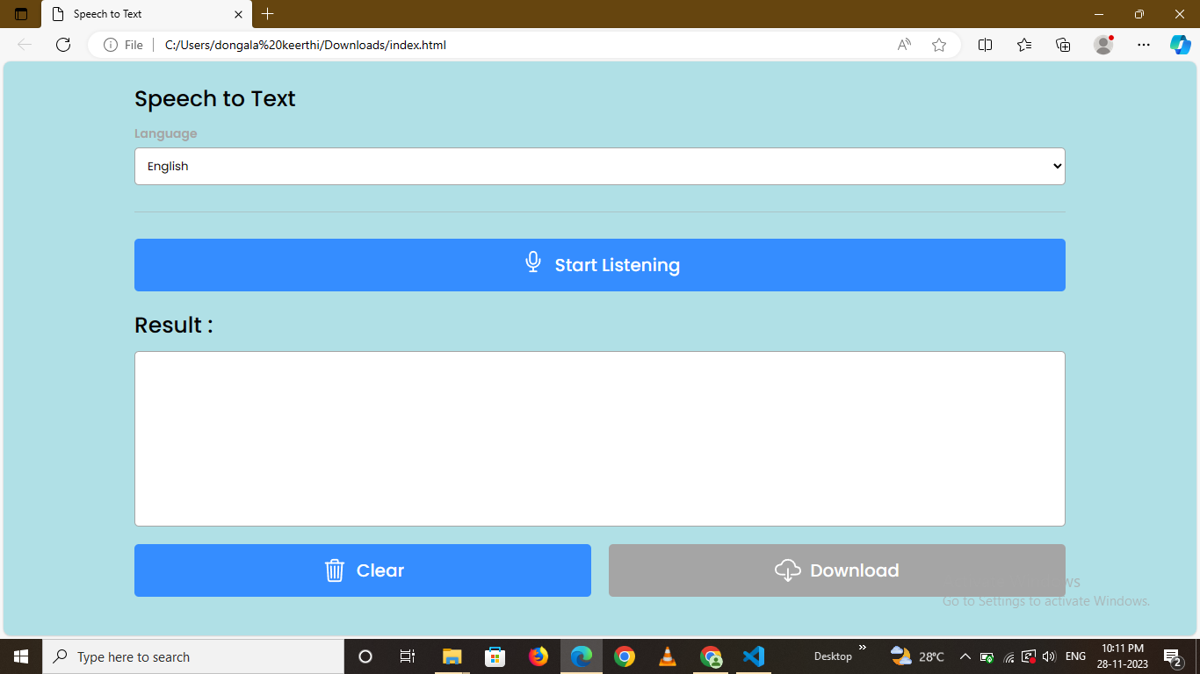

Slide 22
CONCLUSION
Manual note-taking can be difficult, especially while making documents, during meetings or lectures. It is a time consuming task for humans to make notes, prepare documents and writing the emails. To address this challenge, a Speech-Based Automated Note-Making System is proposed. The proposed system enables users to make notes using speech and it transcribes the input speech into equivalent text. This system has an user-friendly interface to make use of the system efficiently. We can also write emails and can edit text by adding editing features to the system. It can be useful for record meetings and generating meeting reports in future by making the necessary changes in the system.

Slide 23
REFERENCES
2022 IEEE International Conference on Distributed Computing and Electrical Circuits and Electronics (ICDCECE) 978-1-6654-8316-2/22/$31.00 ©2022 IEEE Note-ing Hill: A Note-Making Application Vishnu Anand Department of Computer Science PES University Bengaluru, India vishnuanand2000@gmail.com Chinmaya Ravi Department of Computer science PES University Bengaluru, India chinmayaravi@gmail.com Aniket Acharya Department of Computer Science PES University Bengaluru, India aniket.ga8@gmail.com
(APSIPA ASC 2010), pp. 490–493, 2010. [5] S. Natori, H. Nishizaki, and Y. Sekiguchi, “Japanese spoken term detection using syllable transition network derived from multiple speech recognizers’ outputs,” in Proc. of INTERSPEECH2010, pp. 681–684, 2010.
Dua, M.; Aggarwal, R.K.; Biswas, M. Optimizing Integrated Features for Hindi Automatic Speech Recognition System. J. Intell. Syst. 2019, 29, 959–976.

Slide 24
THANK YOU

